Slide 1
SUPPLY CHAIN ADVISORY INITIATIVE | EXECUTIVE BOARD REVIEW
Supply Chain Performance Analysis Brazilian E-Commerce Network
Identifying ₹2.37M in Freight Leakage and 126-Day Delivery Failures Across 118,310 Orders
Prepared by: Sibananda Swain
Supply Chain Data Analyst , June 2026
Technical Stack: Microsoft Excel , Power BI Desktop
Brazilian E-Commerce Olist Dataset (118,310 Records, 2016–2018)
Supply Chain Analytics Infrastructure | Sibananda Swain | June 2026 | Source Data: Public E-Commerce Olist Records via Kaggle
Notes:
This opening slide frames the executive review and establishes the analytical foundation for the deck. It highlights the scale of the dataset, the quantified logistics leakage, and the last-mile delay issue to position the presentation as a data-driven supply chain optimization effort.

Slide 2





Project Mandate: Root-Cause Diagnosis & Capability Architecture
Problem
Execution Sequence
Fragmented e-commerce networks with unmonitored logistics bleed, severe delivery lag in under-developed sub-regions, and siloed transaction tables.
9 Source CSV Files
Power Query Normalization
Mission
Power BI Star Schema
Engine-clean messy multi-source data, build an enterprise relational schema, and project operational clarity through interactive business intelligence.
Custom DAX Engines
3-Page Interactive Platform
Supply Chain Analytics Infrastructure | Sibananda Swain | June 2026 | Source Data: Public E-Commerce Olist Records via Kaggle
Notes:
This slide frames the project as both a data-quality and analytics-architecture effort: first diagnose leakage and delay drivers, then transform fragmented source files into a clean schema and interactive BI layer. Emphasize that the goal is not just reporting, but creating a reusable decision infrastructure for supply chain visibility and exception management.

Slide 3
Data Cleaning and Preparation — Excel Power Query
Data Cleaning Pipeline
Pivot Tables & Key Findings
Pivot #
Metric
Detailed Metrics
olist_orders_dataset — 98.2K rows
olist_order_items — 118.3K rows
olist_customers — 99.4K rows
olist_sellers — 3.1K rows
olist_products — 32.4K rows
olist_order_reviews — 99.4K rows
olist_order_payments — 103.8K rows
PT1
Revenue by Region
São Paulo ₹2.27M (13.8%), Rio De Janeiro ₹1.20M (7.2%), Bottom regions <₹0.1M
PT2
Delivery Delay by Region
Novo Brasil,ES 126 days, Capinzal Do Norte,MA 78 days, Network avg -11.13 days
PT3
Category Performance
Beauty & Health ₹1.49M top, Phones 50.54% freight highest, Bed & Bath 3.89 lowest review
PT4
Monthly Revenue Trend
2016 ₹53K, 2017 ₹7.51M, 2018 ₹8.96M, Growth 168x in 2 years
PT5
Seller Performance
Feira De Santana,BA 33.67 days worst delay, Portoferreira,SP 1.0 score worst review
PT6
Payment Analysis
Credit Card 67.2% = ₹12.78M, Total payments ₹20.42M
Supply Chain Analytics Infrastructure | Sibananda Swain | June 2026 | Source Data: Public E-Commerce Olist Records via Kaggle
Notes:
This slide explains the ETL layer that transformed raw Olist e-commerce tables into a clean analytical model. Key takeaways: the pipeline removed bad records, standardized dates and geography fields, and created reusable summary tables for revenue, logistics delay, and freight analysis.

Slide 4
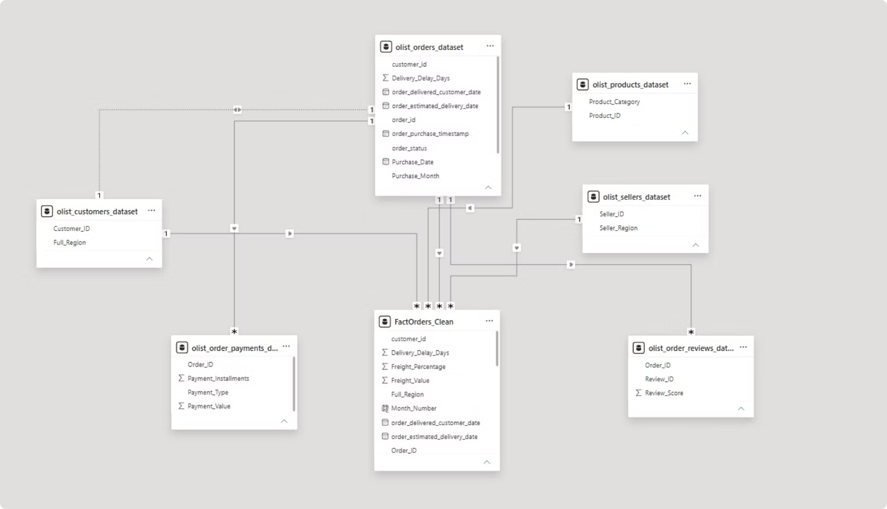
Star Schema Data Model — Power BI
6 Active Relationships
Many-to-One Cardinality
FactOrders_Clean Central Fact Table
9 DAX Measures
Connected all tables One-to-Many
All relationships correctly set
Written from scratch
118,310 rows
This Star Schema mirrors industry-standard data warehouse architecture used in enterprise BI systems
Supply Chain Analytics Infrastructure | Sibananda Swain | June 2026 | Source Data: Public E-Commerce Olist Records via Kaggle
Notes:
This slide introduces the Power BI star schema used to align enterprise data structures for reporting. Emphasize the central fact table, the surrounding dimension tables, and the one-to-many relationships that preserve filter integrity and improve query performance. The key takeaway is that this modeling approach supports scalable analytics and fast, reliable KPI calculation through DAX measures.

Slide 5
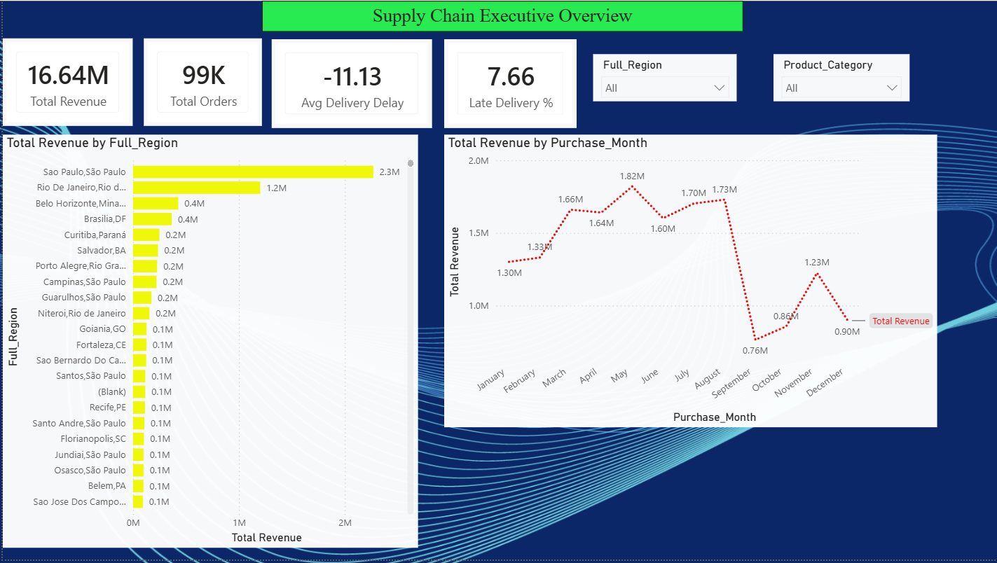
Executive Overview Dashboard
₹16.64M
99K
-11.13
7.66%
Total Revenue
Total Orders
Avg Delivery Delay Days
Late Delivery Rate
São Paulo generates ₹2.3M — 13.8% of total network revenue
Revenue growing from ₹53K (2016) to ₹8.96M (2018) — 168x growth
Monthly peak in November — seasonal demand pattern confirmed
Supply Chain Analytics Infrastructure | Sibananda Swain | June 2026 | Source Data: Public E-Commerce Olist Records via Kaggle
Notes:
This dashboard summarizes the commercial performance baseline across sales, fulfillment, delivery reliability, geography, and seasonality. Key takeaways: sales volume is strong, but delivery performance shows structural issues with a negative average delivery delta and a non-trivial failure rate. Regional concentration in São Paulo and the November seasonal spike highlight where operational planning and risk mitigation should focus.

Slide 6
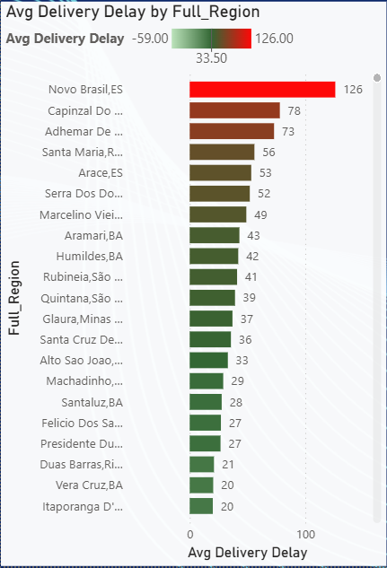
Supply Chain Performance — Delivery Failures Identified
126
Region
Delay Days
Status
Page 2 Delivery Delay Bar Chart
Delivery delay analysis by region
[Placeholder image]
Novo Brasil, ES
126 days
🔴 Critical
Capinzal Do Norte, MA
78 days
🔴 Critical
DAYS
Adhemar De Barros, PR
73 days
🔴 High
Worst Average Delivery Delay
Novo Brasil, ES
Santa Maria, RJ
56 days
🟡 High
Arace, ES
53 days
🟡 Medium
Network Average
-11.13 days
🟢 Acceptable
7,583 orders delivered late out of 99,000 total — Root cause: Carrier concentration in underserved zones
Supply Chain Analytics Infrastructure | Sibananda Swain | June 2026 | Source Data: Public E-Commerce Olist Records via Kaggle
Notes:
This slide highlights the most severe last-mile delivery delays in the network, with Novo Brasil, ES standing out as the highest-risk territory at 126 days of average lag. The table compares the worst-performing locations against the network average, reinforcing where operational intervention is most urgent.

Slide 7
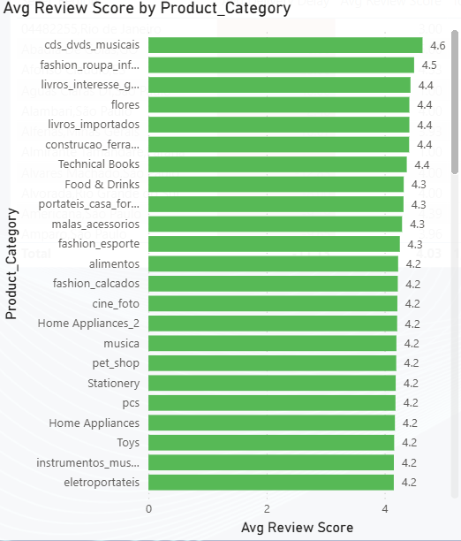

Product Category and Seller Performance
Category
Revenue
Freight %
Beauty & Health
₹1.49M
30.4%
Watches & Gifts
₹1.36M
17.3%
Bed & Bath
₹1.33M
28.9%
Sports & Leisure
₹1.21M
29.5%
Phones
₹0.41M
50.54%
⚠️ PHONES CATEGORY
50.54% Freight Ratio
Highest in entire network
Every ₹2 earned in Phones
₹1 goes to freight costs
Seller insight: Feira De Santana,BA shows 33.67 days delay with only ₹1,296 revenue — low value, high cost seller identified
Supply Chain Analytics Infrastructure | Sibananda Swain | June 2026 | Source Data: Public E-Commerce Olist Records via Kaggle
Notes:
This slide profiles high-revenue categories alongside seller efficiency indicators to highlight where margin pressure and operational friction are most concentrated. Beauty & Health leads revenue, but Handsets / Phones shows the most severe freight burden, indicating a strong need to review shipping economics, seller routing, and fulfillment strategy. The partner note reinforces that longer fulfillment times tend to align with weaker customer reviews, making logistics performance a direct lever for marketplace quality.

Slide 8
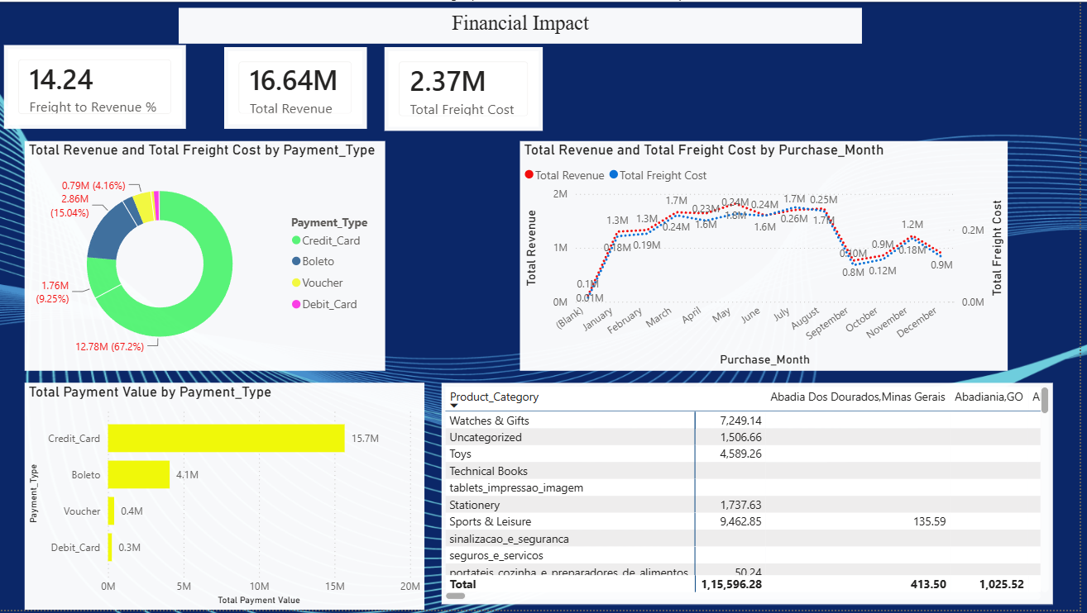




Financial Impact Analysis — Full Picture
14.24%
Freight to Revenue Ratio
Share of revenue absorbed by transit operations
Total Freight Cost Annual
Annual freight leakage across the network
₹2.37M
Total Payment Value Processed
Overall transaction volume across payment modes
₹20.42M
Payment Split Table
Settlement Mode
Share
Gross Value
Category
Credit Card
67.2%
₹15.78M
Primary
Key Insight
Credit Card dominates — 67.2% dependency on single payment method
Boleto
15.04%
₹4.16M
Secondary
Voucher
9.25%
₹0.46M
Secondary
Debit Card
4.16%
₹0.30M
Secondary
Supply Chain Analytics Infrastructure | Sibananda Swain | June 2026 | Source Data: Public E-Commerce Olist Records via Kaggle
Notes:
This slide highlights where value is being absorbed by logistics and how transaction volume is concentrated across payment channels. The key takeaway is that freight leakage is material, while credit card dependence creates both cost and operational risk.

Slide 9
Summary of All Findings
FINDING 1: DELIVERY FAILURE
FINDING 2: FREIGHT LEAKAGE
FINDING 3: REVENUE PATTERN
Novo Brasil, ES: 126 days delay
Capinzal Do Norte, MA: 78 days delay
Network late rate: 7.66% of all orders
7,583 orders delivered late
Overall avg delay: -11.13 days (some regions pulling average down but specific zones critical)
₹2.37M spent on freight annually
14.24% of total revenue going to logistics costs
Phones category: 50.54% freight ratio — highest risk
Home Utilities: 40.32% ratio — second highest
Network needs freight optimization across top 5 categories
₹16.64M total revenue 2016-2018
São Paulo = 13.8%
Rio De Janeiro = 7.2%
Top 2 = 21% total
Revenue grew 168x from 2016 to 2018 showing strong growth
Credit Card: 67.2% of payments — Single method risk identified
Supply Chain Analytics Infrastructure | Sibananda Swain | June 2026 | Source Data: Public E-Commerce Olist Records via Kaggle
Notes:
This slide provides a concise summary of the critical issues identified across the supply chain, categorizing them into delivery failures, freight leakage, and revenue patterns. The `solidBoxes` layout highlights each finding with a distinct color, making the information easily digestible and emphasizing the core problems that require attention. It's a quick reference point for stakeholders to grasp the major challenges.

Slide 10
Summary of All Findings
MONTH 1–3: QUICK WINS
MONTH 4–8: OPTIMIZATION
MONTH 9–12: SCALE
Fix Delivery Regions
Problem: 126-day delays in ES, MA
Actions:
Fix Freight Costs
Problem: 14.24% freight ratio too high, Phones at 50.54%
Actions:
Grow Revenue
Problem: Revenue concentrated in only 2–3 regions
Actions:
Identify worst 10 delay sellers
Review carrier contracts in ES+MA
Set 15-day maximum SLA standard
Weekly delay monitoring using Page 2 of Power BI dashboard
Renegotiate freight rates for Phones and Electronics
Explore bulk shipping options
Review packaging to reduce dimensional weight charges
Monthly tracking on Page 3
Expand seller network in underperforming regions
Launch seller incentive for high-performing regions
Use Page 1 dashboard for monthly executive review
Quarterly performance reports
Target: Late delivery % below 5%
Target: Freight ratio below 10%, Saving ₹700K annually
Target: Revenue growth 15%+, Review score above 4.3
Month 3: Late delivery below 5% | Month 8: Freight below 10% | Month 12: Revenue +15%
Supply Chain Analytics Infrastructure | Sibananda Swain | June 2026 | Source Data: Public E-Commerce Olist Records via Kaggle
Notes:
This slide presents a clear three-part action plan over 12 months, moving from delivery stabilization to freight optimization and then growth expansion. The timeline at the bottom reinforces the milestone checkpoints and keeps the recommendations easy to scan for decision-makers.

Slide 11
Thank You
Supply Chain Data Analyst
WHAT I BUILT
DATA ANALYZED
TOOLS USED
3-page Power BI Dashboard
9 DAX Measures
Star Schema Data Model
6 Active Relationships
118,310 Orders
7 Cleaned Tables
6 Pivot Tables
Real Business Insights
Microsoft Excel
Power Query ETL
Power BI Desktop
Kaggle Dataset
GitHub: github.com/sibananda-swain/supply-chain-analytics
LinkedIn: linkedin.com/in/sibananda-swain
Supply Chain Analytics | June 2026 | Sibananda Swain
Source: Brazilian E-Commerce Olist Dataset | Kaggle.com

